Slide 1




Do not Forget Hardware Prefetching When Designing Secure Cache Systems Sumon Nath | 21Q050007 Guided by Biswabandan Panda
MS Thesis Defence
CSE, IIT Bombay
CASPER

Slide 2


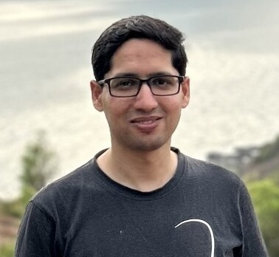
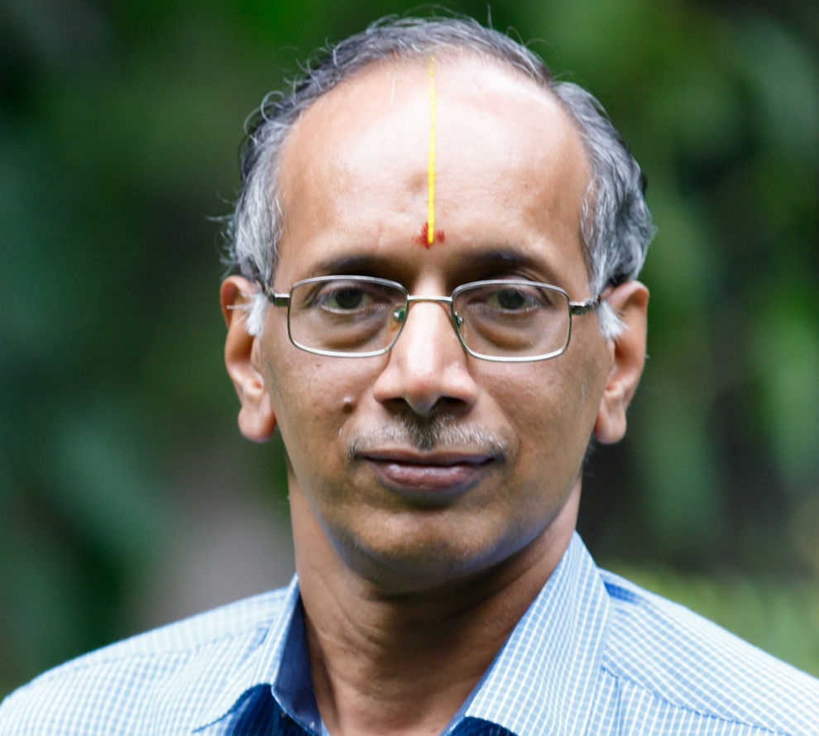
Thesis committee
Prof. Biswabandan Panda
IIT Bombay
Prof. Mythili Vutukuru
IIT Bombay
Prof. Manas Thakur
IIT Bombay
Prof. R. Govindarajan
IISc Bangalore

Slide 3



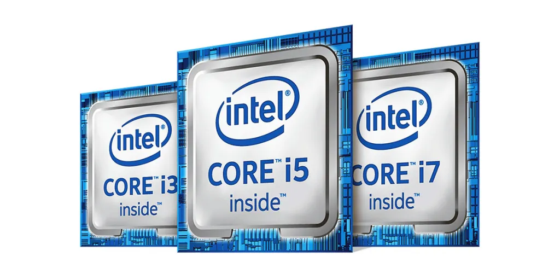


Need for Speed

Slide 4



Microarchitecture optimizations
Caches
TLBs
Branch predictor
Out-of-order execution
Hyper threading
Prefetchers

Slide 5

What about security?
Caches
TLBs
Branch predictor
Out-of-order execution
Hyper threading
Prefetchers

Slide 6


What about security?
Caches
TLBs
Branch predictor
Out-of-order execution
Hyper threading
Prefetchers

Slide 7


Security – Performance cost
Prefetchers

Slide 8

Secure prefetching – performance cost
11% perf. drop on average
*Intel and AMD spent three years to get 3% improvement

Slide 9
How it started?

Slide 10
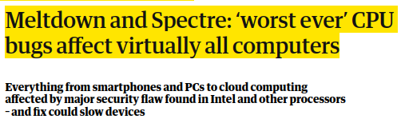


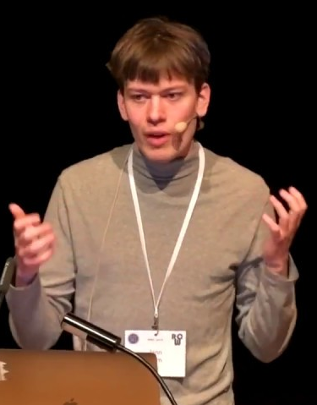
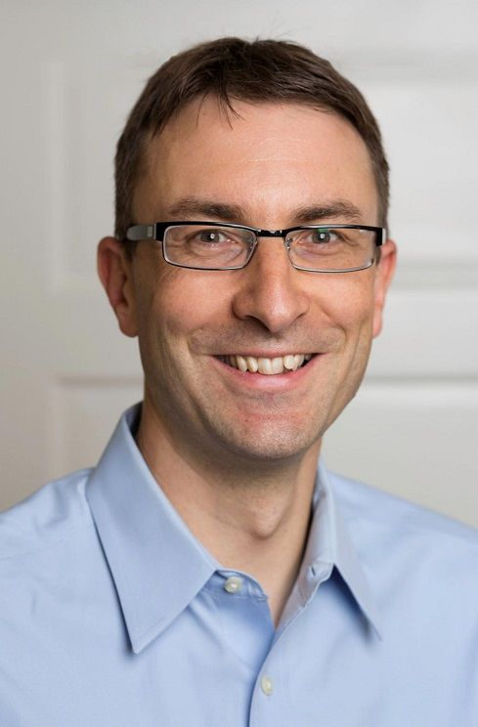
The Year 2018
Found a critical microarchitecture flaw
Flaw allowed attacker to read sensitive information from memory
Exploited Speculative execution & caches

Slide 11

In recent years: Speculative Execution Attacks
Spectre [S&P, 2019] SMoTherSpectre [CCS, 2019]
Speculative interference [ASPLOS, 2021] PacMan [ISCA 2022] Downfall [Usenix Security, 2023] Phantom [MICRO 2023]
Slam [S&P, 2024] GadgetSpinner [HPCA 2024]
Notes:
Conference in architecture and security

Slide 12
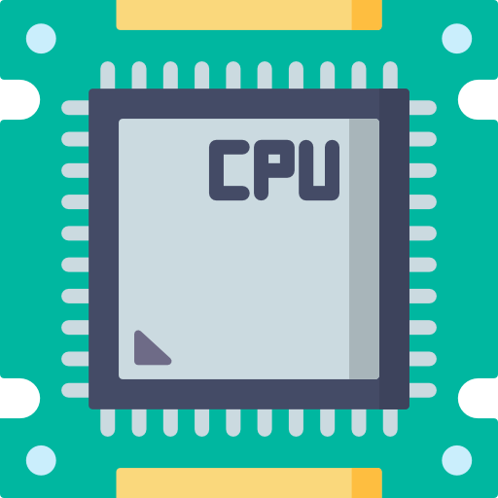


Branch Predictor and speculative execution
CPU speculates on a branch (e.g. an if condition) to gain perf.
I₁
I₂
I₃
I₄
I₅
LOAD
BRANCH
SUB
ADD
Speculative instrs.
MUL
Instructions Sequence
Notes:
Starts executing instruction along the predicted path

Slide 13

Spectre variant I
if (x < array1_size)
y = array2[array1[x]*2048]
x = 400 (out-of-bounds)
x = 0
h
e
l
l
o
s
e
c
r
e
t
array1
0
1
2
3
4
400
401
401
402
403
404
Notes:
Connect with google

Slide 14



Spectre variant I
Wrong decision by branch predictor facilitates access of Secret
if (x < array1_size)
y = array2[array1[x]*2048]

Slide 15

Spectre variant I
Wrong decision by branch predictor facilitates access of Secret
if (x < array1_size)
y = array2[array1[x]*2048]

Slide 16

Spectre variant I
Wrong decision by branch predictor facilitates access of Secret
if (x < array1_size)
y = array2[array1[x]*2048]
Even though processor state is restored
Secret remains in cache for attacker to exploit

Slide 17
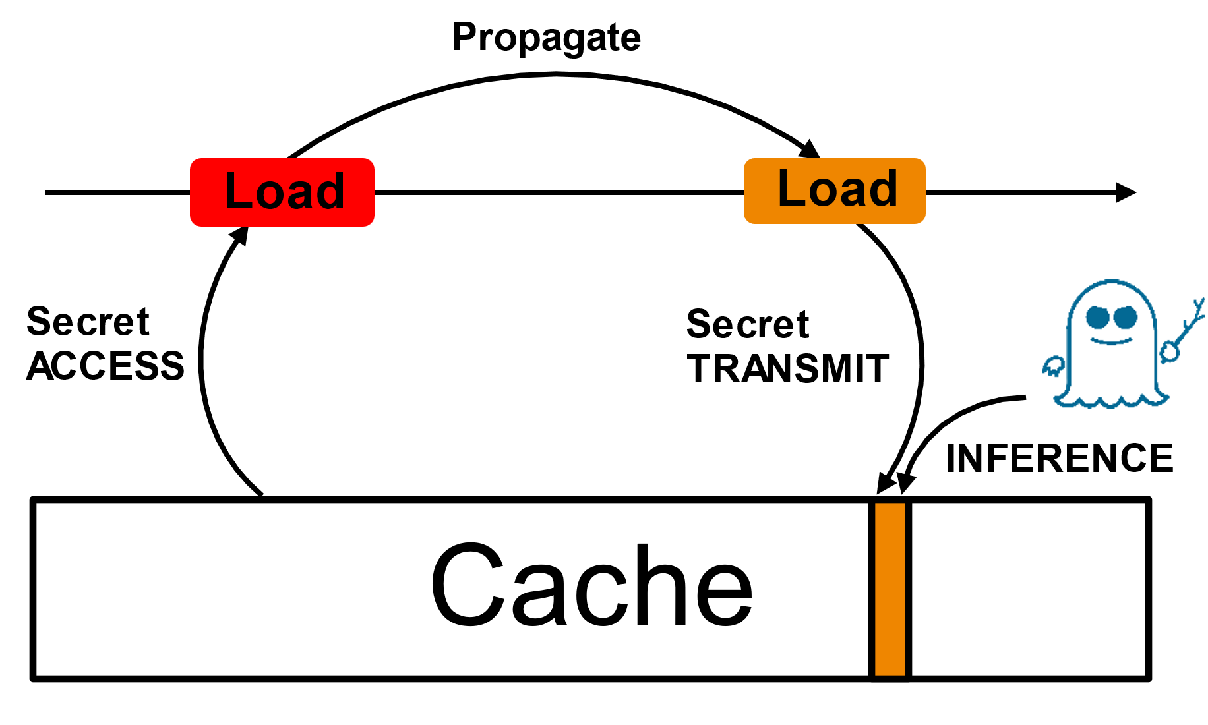
Timeline of a speculative execution attack
if (x < array1_size)
y = array2[array1[x]*2048]
if (x < array1_size) secret = array1[x] y = array2[secret*2048] array2[0] array2[1 * 2048] array2[2 * 2048] ...

Slide 18

Current mitigations
CleanupSpec [MICRO ‘19]
Doppelganger [ISCA ‘23]
Invisispec [MICRO ‘18]
STT [MICRO ‘19]
Time
DoM [ISCA ‘19]
NDA [MICRO ‘19]
GhostMinion [MICRO ‘21]

Slide 19

Current mitigations
NDA: Stops PROPAGATION
Delay-based
Notes:
Non-speculative data access

Slide 20
Current mitigations
STT/DOM : Stops TRANSIMISSION
Delay-based
Notes:
Speculative taint tracking/ Delay on miss

Slide 21

Current mitigations
InvisiSpec/GhostMinion : Stops INFERENCE
Invisible
Speculation

Slide 22
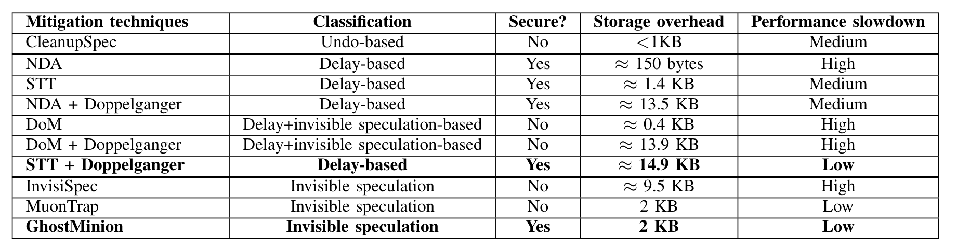
Microarchitecture mitigations
Notes:
Add other mitigations too

Slide 23

The good one: GhostMinion
CPU
L1D
GM cache
L2
GM cache
Stores all speculative data
Wiped on mis-speculation
LLC
DRAM

Slide 24
Devil is in the details
CPU
Speculative path
Commit Write – hit in GM
Commit Load – miss in GM
Re-fetch
L1D
GM
Writeback
Cache state untouched
LRU bits not updated on hit
Bypass fills to L1/L2/LLC
L2
LLC
Caches updated On-commit
Writeback to L1-> L2 -> LLC
Re-fetch to L1
DRAM

Slide 25

Is prefetching secure?
Train
CPU
Prefetcher
L1D
GM cache
Trigger
PrefetchX [HPCA ‘24]
L2
Augury [S&P ‘22]
Speculative prefetching
GoFetch [USENIX ‘24]
LLC
DRAM

Slide 26
Is prefetching secure?
Train
CPU
Prefetcher
L1D
GM cache
Trigger
Train & Trigger
On-access
On-commit
L2
Speculative prefetching
LLC
DRAM

Slide 27
The cost of secure cache system
11% perf. drop on average
*Baseline:
Non-secure cache system with
NO prefetching
Notes:
Put arrows between white bar and black bar in Berti

Slide 28
Our work

Slide 29
Our goal, insights and contributions
Can we design secure prefetcher that can work synergistically with secure cache system, without losing performance?
Negative impact of secure cache system on prefetching
(Memory traffic)
Secure update filter (SUF)
Timeliness issues with
secure prefetching
Timely secure Berti (TSB)

Slide 30

Problem 1: Increased traffic
L1D
Demand Requests
Commit Requests
Prefetch Requests

Slide 31
Problem 1: Impact of secure cache system

Slide 32
Problem 1: Impact of secure cache system
Average Traffic increases from 199 to 375 accesses per kilo instruction (APKI)

Slide 33
Increase in miss latency
L1D load miss latency increases from 83 to 117 cycles

Slide 34
Redundant requests to cache system
CPU
Speculative path
Commit Write
Commit Load
Re-fetch
L1D
GM
Writeback
More than 95% redundant commit requests to L1D
L2
LLC
DRAM

Slide 35

Enhancement 1: Secure update filter (SUF)
LQ
Speculative Path
…
Commit Path
❶
Hit-level (HL, 2 bit)
L2 writeback bit
Hit level: cache level that served the request
Writeback bit (wbb)
Security guarantees
Filters out commit requests
Commit requests do not leak speculative info.
❷
GM
HL!=00
Y
L1D
N
DROP
❸
L2
Y
Filtering accuracy > 99%
❹
wbb?
Y
wbb
Storage overhead 0.12 KB
wbb?
N
LLC
DROP
N
DROP

Slide 36
Enhancement 1: Secure update filter (SUF)
Improves perf. of secure cache system by 3.4%

Slide 37
Enhancement 1: Secure update filter (SUF)
Improves perf. of secure cache system by 3.4%

Slide 38
Berti prefetcher
.
.
.
.
.
2@
5@
10@
12@
15@
Timeline
Deltas: +5, +3
Time to fetch address 15
Timely deltas: +10, +13

Slide 39
Berti Training
.
.
.
.
.
.
2@
5@
10@
12@
15@
15_{fill}
0
10
30
50
70
120
Timeline
Time to fetch = 50
Fill Latency = 50
Timely deltas: +10, +13
History table
@ TimeStamp
Table of Deltas
2 0
5 10
Delta Coverage Destination
10 30
+10 2/2 (100%) L1D
12 50
+13 1/2 (50%) L2C
15 70

Slide 40

Berti: Insecure ☹
.
.
.
.
.
.
2@
5@
10@
12@
15@
15_{fill}
0
10
30
50
70
120
Timeline
Time to fetch = 50
Fill Latency = 50
Timely deltas: +10, +13
History table
Trained & Triggered on-access
@ TimeStamp
Table of Deltas
2 0
5 10
Delta Coverage Destination
10 30
+10 2/2 (100%) L1D
12 50
+13 1/2 (50%) L2C
15 70

Slide 41
Berti: Insecure ☹
.
.
.
.
.
.
2@
5@
10@
12@
15@
15_{fill}
0
10
30
50
70
120
Timeline
Time to fetch = 50
Fill Latency = 50
Train on-commit
Don’t use speculative info.
Trigger prefetch on-commit
Timely deltas: +10, +13
History table
Trained & Triggered on-access
@ TimeStamp
Table of Deltas
2 0
5 10
Delta Coverage Destination
10 30
+10 2/2 (100%) L1D
12 50
+13 1/2 (50%) L2C
15 70

Slide 42
Berti: On-commit
.
.
.
.
.
.
2@
5@
10@
12@
15@
15_{fill}
0
10
30
50
70
120
Timeline
Fill Latency = 50

Slide 43
Berti: On-commit
.
.
.
.
.
.
.
.
2@
5@
10@
12@
15@
15_{fill}
15_{commit}
15_{writeback}
0
10
30
50
70
120
130
140
Timeline
Fill Latency = 50

Slide 44
Berti: On-commit
.
.
.
.
.
.
.
2_{commit}
5_{commit}
15@
10_{commit}
15_{fill}
15_{commit}
15_{writeback}
20
40
70
90
120
130
140
Timeline
Fill Latency = 50

Slide 45


Berti: On-commit [Problem 2]
1
.
.
.
.
.
.
.
2_{commit}
5_{commit}
15@
10_{commit}
15_{fill}
15_{commit}
15_{writeback}
20
50
70
90
120
130
140
Timeline
Fill Latency = 50
Fill Latency = 10
2
Notes:
There is no point in covering the commit, rather it should be covering the access
Fill latency seen by the prefetcher is wrong

Slide 46
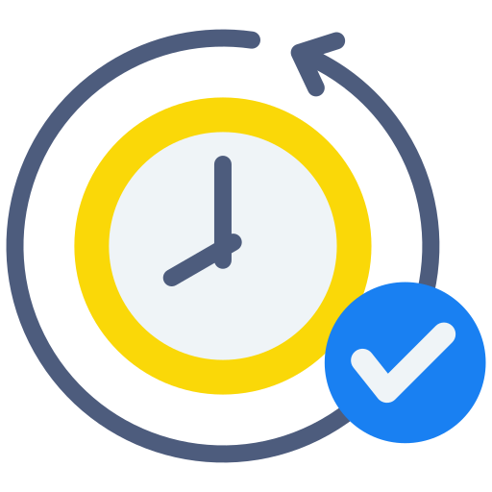



Timely Secure Berti [Enhancement 2]
Train
Trigger
.
.
.
.
.
.
.
2_{commit}
5_{commit}
15@
10_{commit}
15_{fill}
15_{commit}
15_{writeback}
20
50
70
90
120
130
140
Timeline
Fill Latency = 50
Fill Latency = 10
Prefetch should cover access
Fill latency should be correct
Notes:
There is no point in covering the commit, rather it should be covering the access

Slide 47
Timely Secure Berti (TSB)
Train
Trigger
.
.
.
.
.
.
.
2_{commit}
5_{commit}
15@
10_{commit}
15_{fill}
15_{commit}
15_{writeback}
20
50
70
90
120
130
140
Security guarantees
Prefetcher is trained and triggered on-commit
Speculative info. stored in X-LQ is safe
Timeline
Fill Latency = 50
History table
Extended Load Queue (X-LQ)
commit TimeStamp
Instr. |  | Access TS | Fill Latency
<ID> |  | 70 | 50
2 20
5 50
10 90
Storage overhead 0.47 KB
15 130
Notes:
There is no point in covering the commit, rather it should be covering the access

Slide 48


SUF + TSB in nutshell
CPU
Prefetcher
L1D
GM cache
L2
Timeliness issue
Increased memory traffic
TSB
LLC
SUF
DRAM

Slide 49
Applicability
Invisible speculation based techniques which updates the cache hierarchy on commit
SUF
Delay based techniques
TSB
All secure cache systems

Slide 50

Evaluation setup
Champsim (Intel Sunny Cove)
Normalized to non-secure cache system without prefetching
SPEC CPU2017 & GAP benchmarks

Slide 51
Performance improvement
TSB + SUF improves performance by 6.3 % compared to On-commit Berti

Slide 52
Power reduction
SUF reduces dynamic energy consumption by 9.1%

Slide 53
Multi-core performance
TSB + SUF improves performance by 23% compared to on-commit Berti

Slide 54
Non-self timing prefetchers
Prefetcher | Performance improvement compared to on-commit version
TS-Stride | 3.1 %
TS-IPCP | 2.84 %
TS-SPP+PPF | 1.92 %
TS-Bingo | 2.64 %
Timely-secure prefetcher
Increase prefetch distance with increase in lateness

Slide 55
Conclusion
Secure cache systems hinder prefetcher performance (conflicting tradeoffs)
Prefetchers not designed keeping security in mind
First work that provides a win-win trade off
*Under review in MICRO ‘24

Slide 56
Response to external reviewer
It would be nice to see an argument on how the proposed filtering (SUF) does not result in any information leak.
- Updated in thesis (Section 5.1)
Whether the problem (increased traffic) and the proposed solution (SUF) are specific to Berti?
- Memory traffic increases significantly with other prefetchers and hence the performance benefits

Slide 57
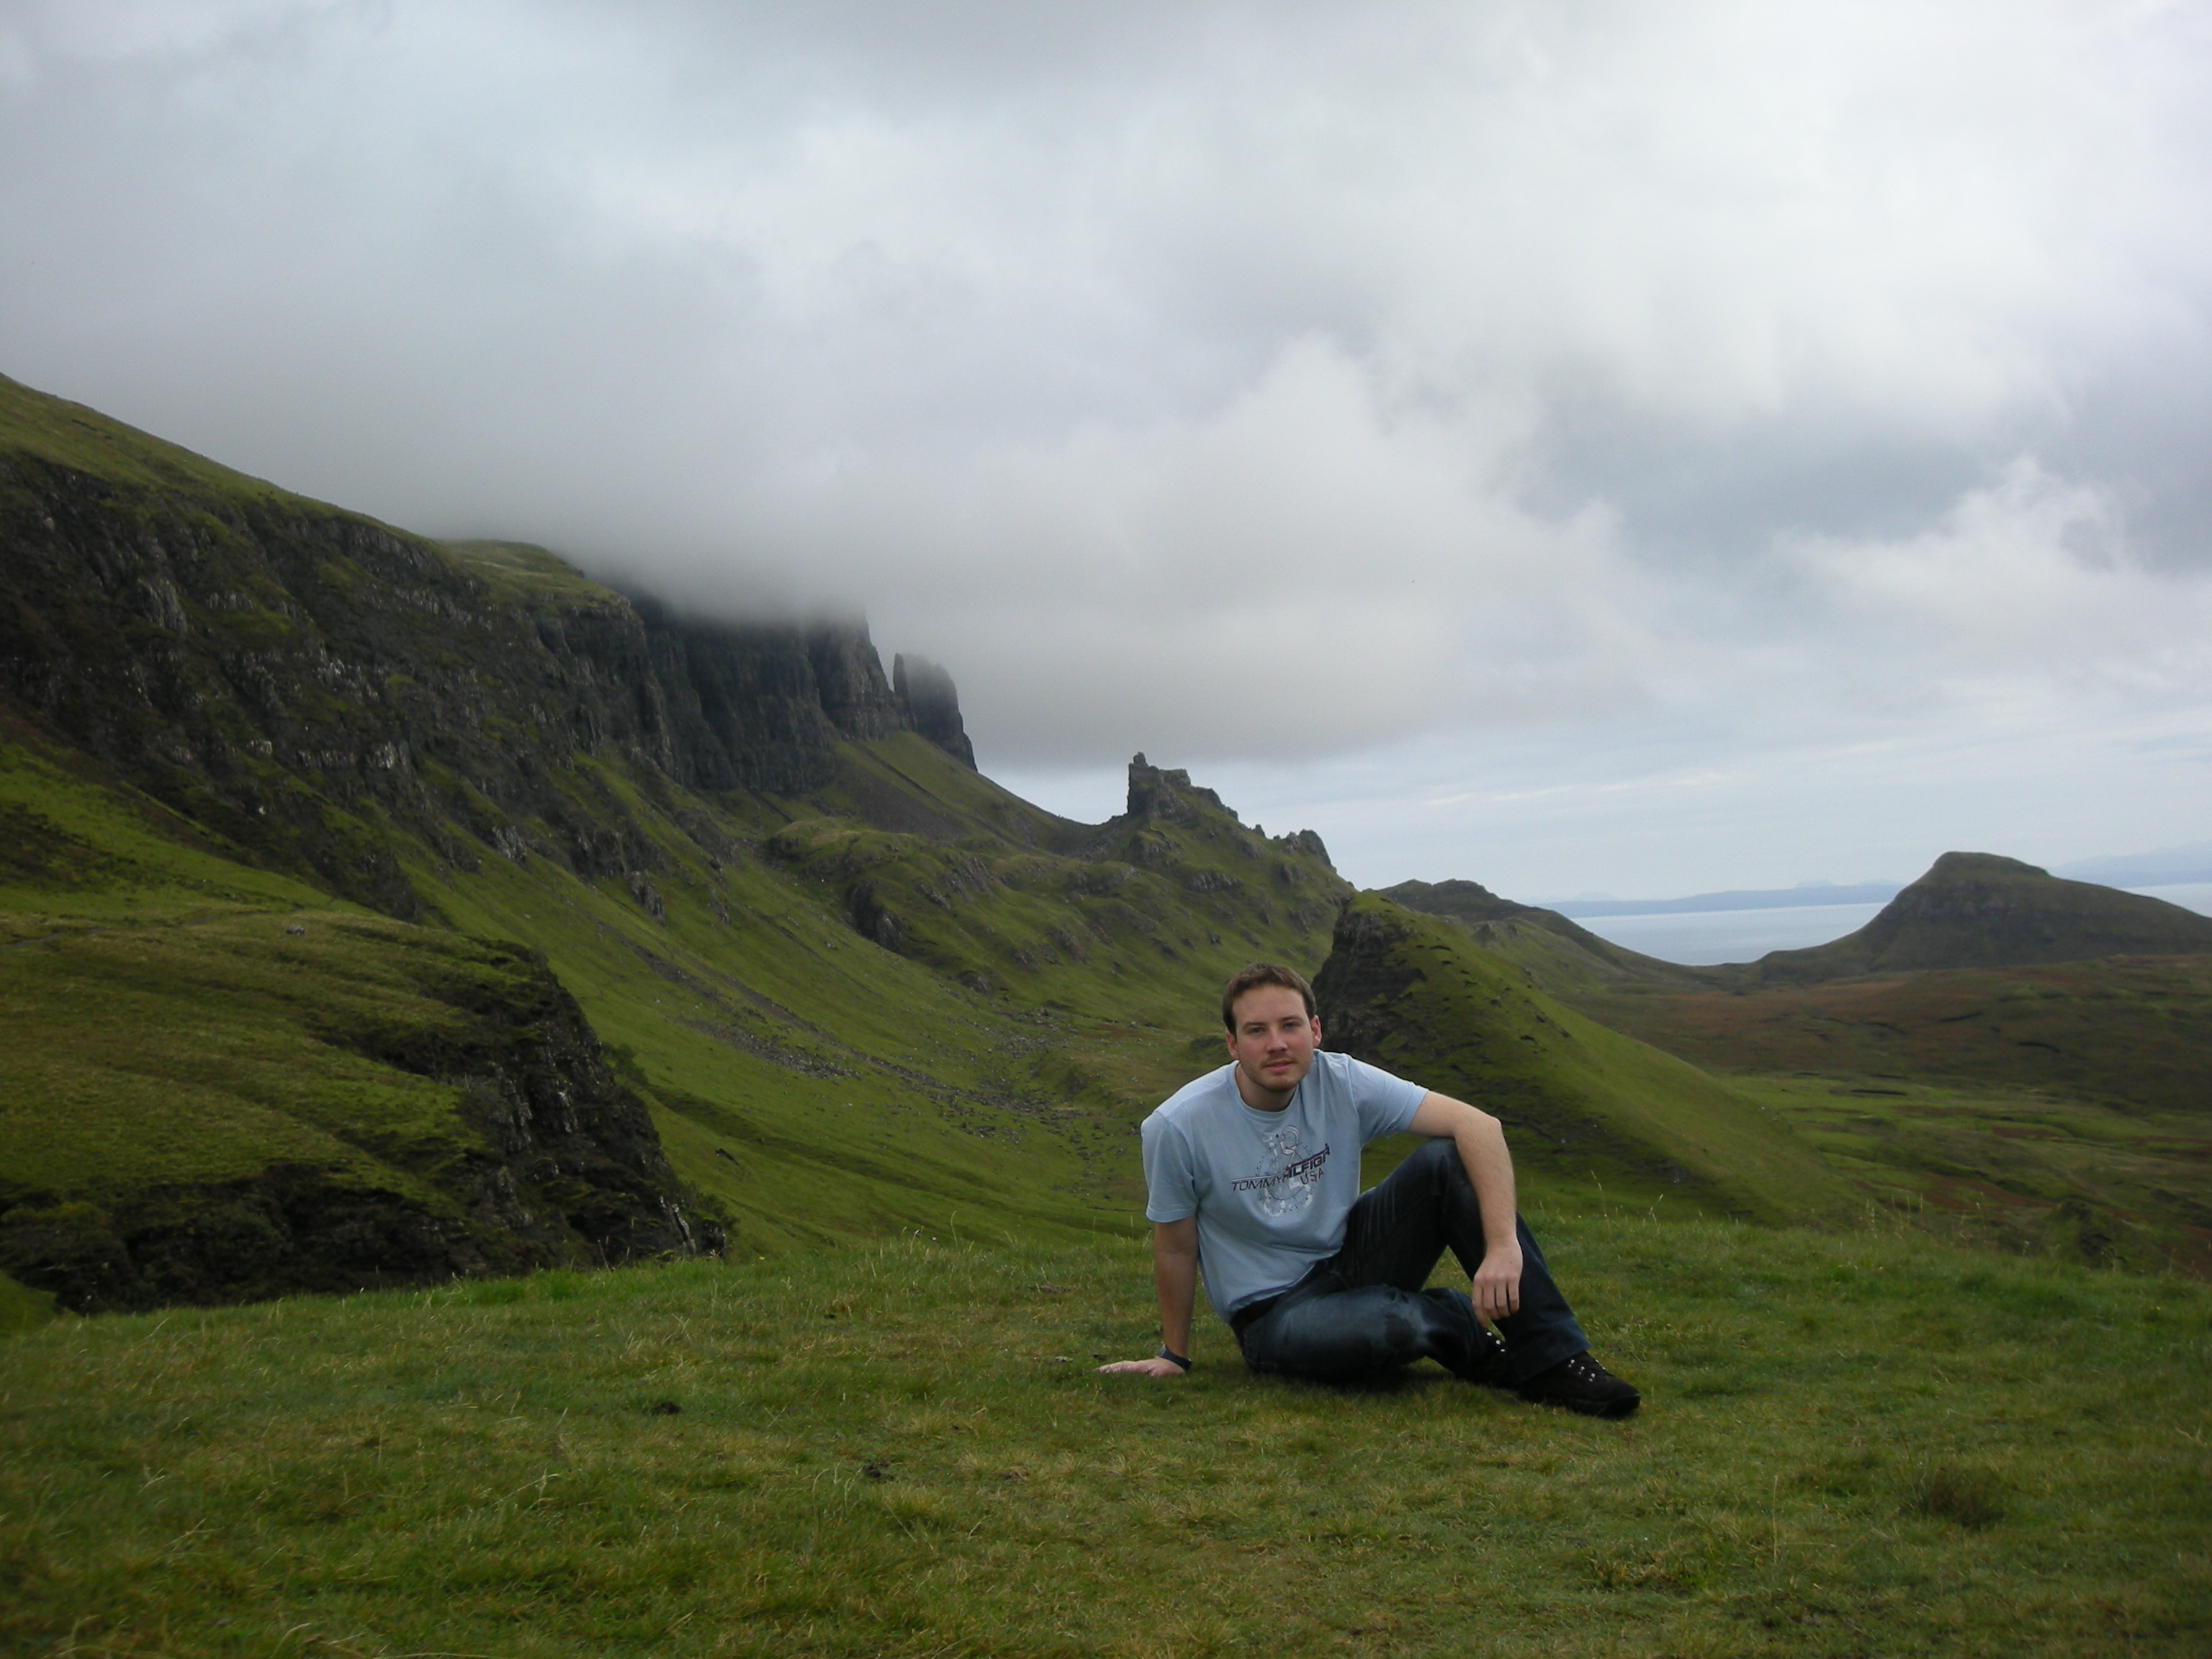

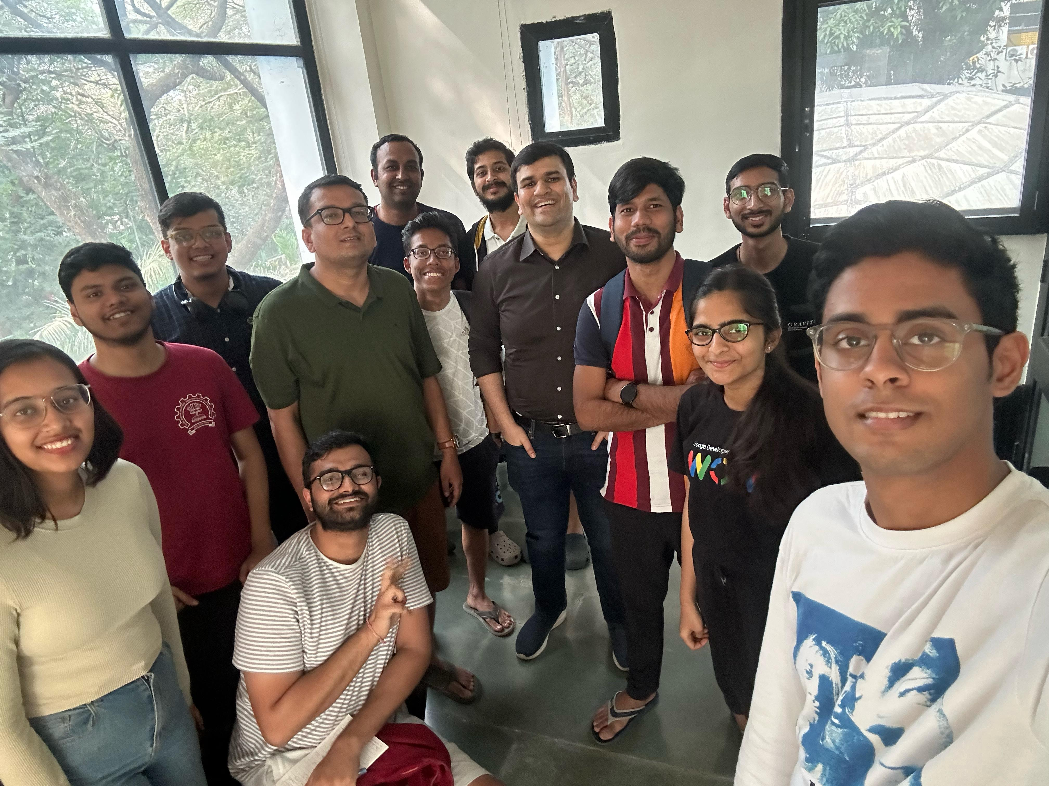
Acknowledgements
Thanks to Prof. Biswa, Prof. Alberto Ros and Agustin Navarro-Torres
Thanks to my friends, especially Nishkarsh and Shubham

Slide 58

Thank You
CASPER
Images Flaticon

Slide 59
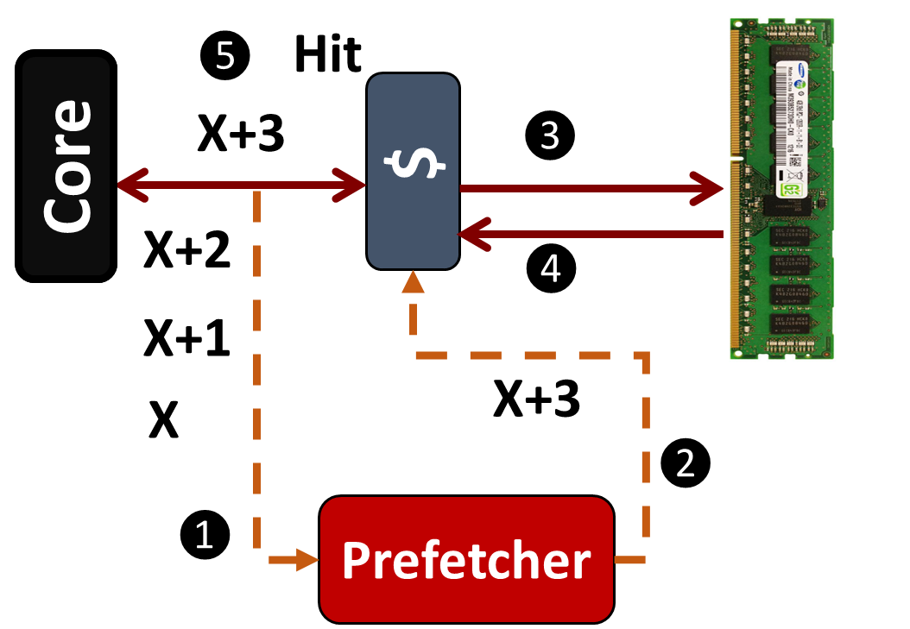

Towards 100% hit rate: Hardware Prefetching
Prefetchers improve performance by an average of 30%
Timeliness is
the key
Notes:
Timing - cover drive

Slide 60
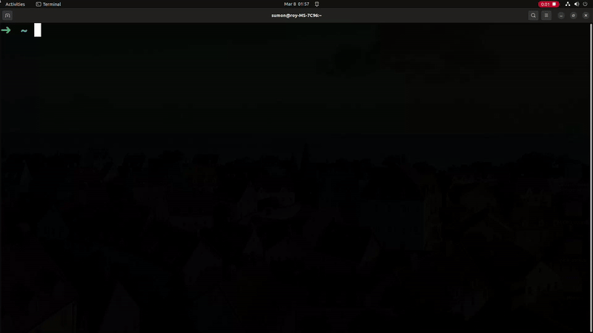
How this affects you?
Tons of software patches: costly solution: 70% performance drop

Slide 61
Timely prefetch if prefetcher trained on-access
On-commit prefetching Timeliness
Timely prefetch if prefetcher trained on-access
Not prefetched on-commit
Prefetched late on-commit
L2
Commit Late prefetches increases overall MPKI

